Slide 1

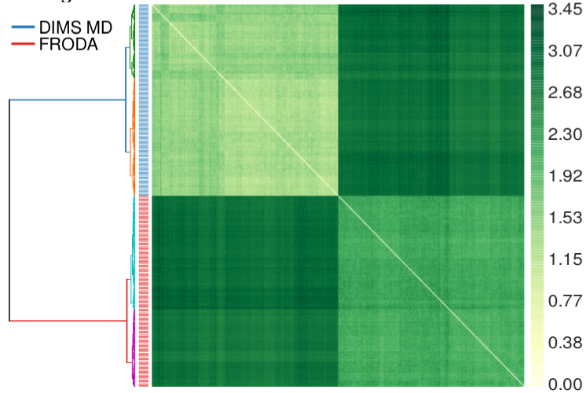
Parallelizing analysis of biomolecular simulations: MDAnalysis with MIDAS radical.pilot
analysis of ensembles of molecular dynamics (MD) trajectories: MDAnalysis Python library http://mdanalysis.org
MAP-REDUCE with MIDAS radical.pilot http://radical-cybertools.github.io/radical-pilot/
}
MDAnalysis python script 1
MAP
REDUCE
MDAnalysis python script 2
MDAnalysis python script
MDAnalysis python script 3
MDAnalysis python script 4
radical.pilot
MDAnalysis python script 5

Slide 2
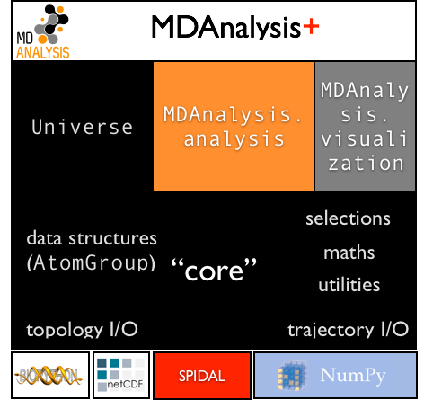
MDAnalysis http://mdanalysis.org
Open source Python Library that abstracts access to all common trajectory data formats used in the biomolecular simulation field.
International developer (7 core developers, 36 contributors, 2 GSoC students, 2 REU students) and user community (~1k downloads per release, >250 citations) https://github.org/MDAnalysis
Python/Cython/C
object oriented
~45k LOC
~24k lines comments
> 4000 tests with CI
licence GPL v2
extensive documentation http://mdanalysis.org

Slide 3
“Topology” + “Trajectory” = “Universe”
Universe binds topology (atom descriptions, static) and trajectory (coordinates, dynamic) data together
import MDAnalysis as mda
u = mda.Universe(‘topol.tpr’, ‘traj.xtc’)
print(u)
<Universe with 12421 atoms and 8993 bonds>
Particles are stored as AtomGroups
print(u.atoms)
<AtomGroup with 12421 atoms>
Iterate over time steps in trajectory and process atoms
for ts in u.trajectory:
analyze_func(u.atoms)

Slide 4
Accessing atoms: selections & AtomGroup
Create new groups with atom selections (full query language):
protein =
u.atoms.select_atoms(
“protein and backbone”)
print(protein)
<AtomGroup with 2113 atoms>
AtomGroups behave like Python lists
print(list(protein[:5]))
[<Atom 1: N of type NH3 of resname ALA, resid 1 and segid IFAB>,
<Atom 2: HT1 of type HC of resname ALA, resid 1 and segid IFAB>,
<Atom 3: HT2 of type HC of resname ALA, resid 1 and segid IFAB>,
<Atom 4: HT3 of type HC of resname ALA, resid 1 and segid IFAB>,
<Atom 5: CA of type CT1 of resname ALA, resid 1 and segid IFAB>]]

Slide 5
Fundamental abstraction: AtomGroup
Selections allow fine control over which part of the system to analyze.
solvshell =
u.atoms.select_atoms(
“resname SOL and
around 5.0 protein”)
print(solvshell)
<AtomGroup with 2792 atoms>
AtomGroups can be combined and written to files in any format.
ag = protein + solvshell
ag.write(“prot_shell.pdb”)
print(ag)
<AtomGroup with 4905 atoms>

Slide 6
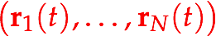
Atom data as NumPy arrays
AtomGroups contain particles (“atoms”).
Properties of all particles are NumPy arrays (common data structure in all scientific Python code: interoperability)
ag.names
array(['N', 'HT1', 'HT2', ..., 'OH2', 'H1', 'H2'],
dtype='|S4')
ag.charges
array([-0.3 , 0.33 , 0.33 ,
...,
-0.834, 0.417, 0.417])
ag.positions
array([[-12.57699966, 10.42199993, -5.22900009],
[-13.59200001, 10.19900036, -5.19299984],
[-12.31599998, 10.22900009, -6.21700001],
...,
[ -5.02600002, -12.31200027, 13.30200005],
[ -5.45100021, -11.82499981, 12.59500027],
[ -4.14099979, -12.47900009, 12.97900009]],
dtype=float32)
ag.velocities
ag.forces

Slide 7
Basic analysis pattern: Iterate over frames
trajectories contain frames: one snapshot of all particles at a specific time (positions[, velocities[, forces]])
Universe.trajectory is a Python iterable
Python iterator syntax (e.g., slicing every 10th frame)
for ts in u.trajectory[::10]:
analyze(ag.positions)
AtomGroup.positions updates every step
iteration reads data from disk for each frame (out of core processing, no limitations to trajectory and system sizes)
alternatively: load a subset of all coordinates into a NumPy array and hold it all in memory for fast processing:
positions_protein = u.trajectory.timeseries(protein)

Slide 8
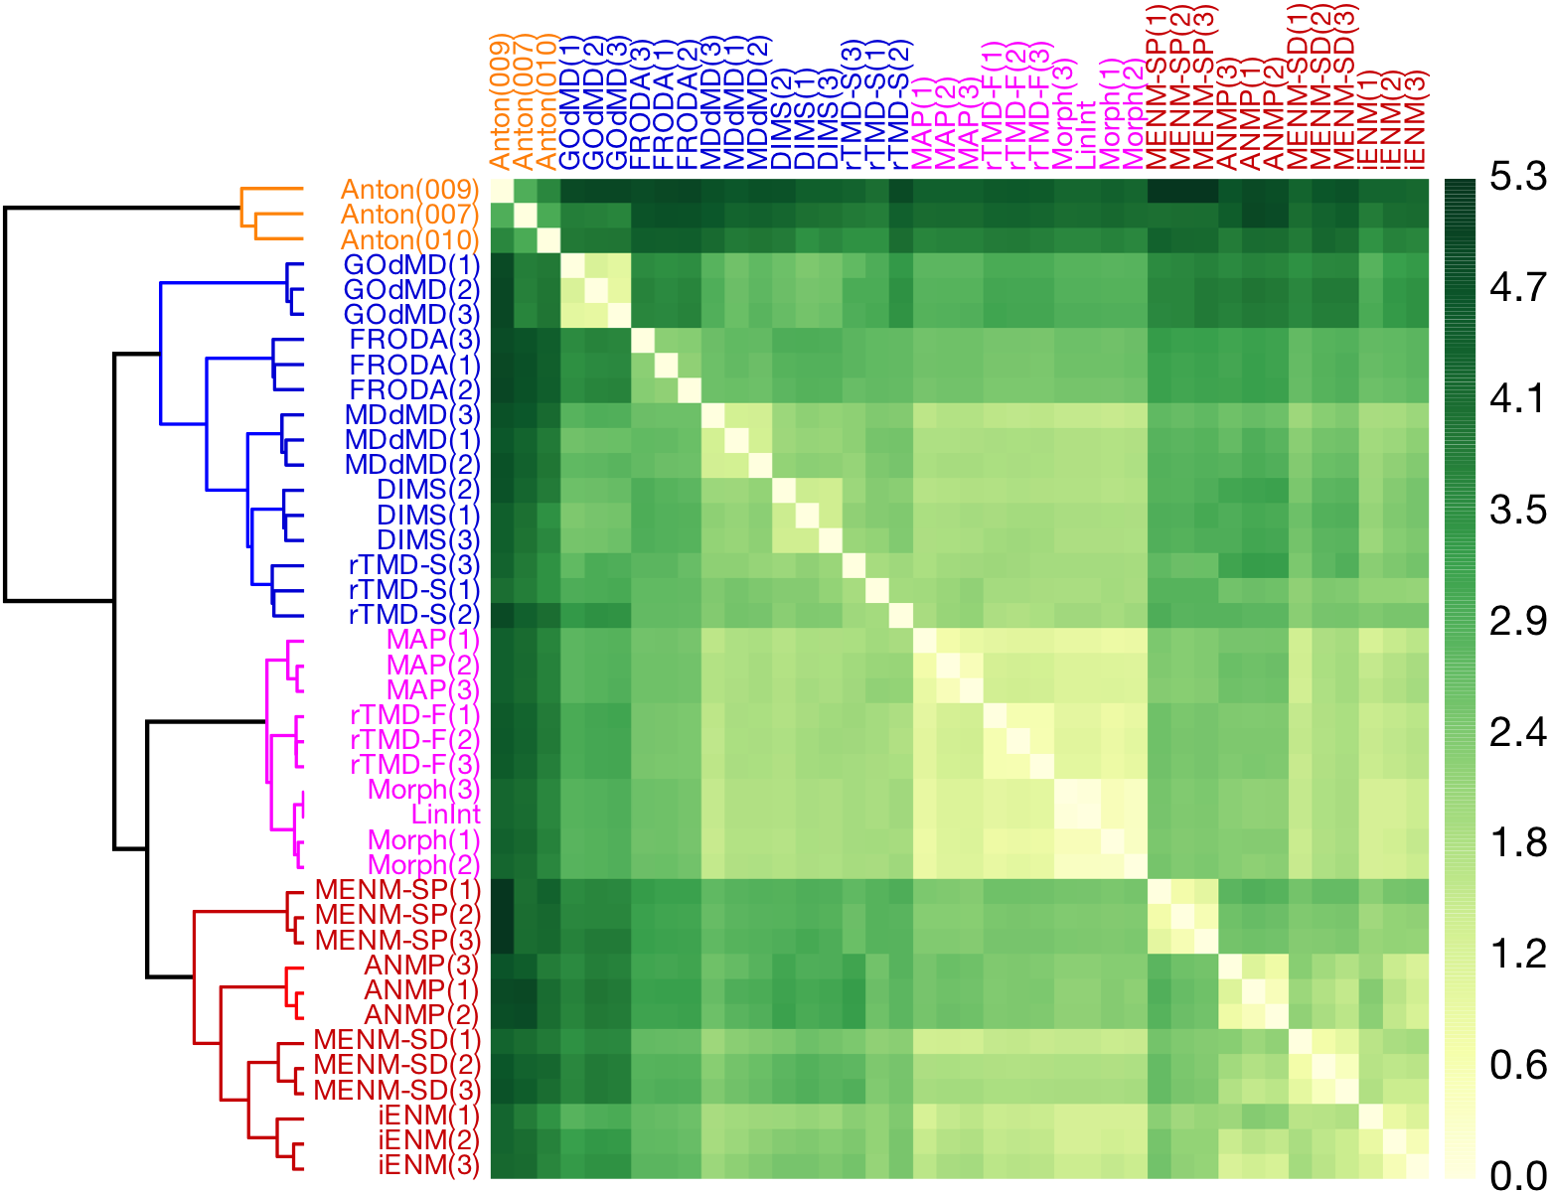
Path Similarity Analysis*
quantify difference between trajectories (paths P, Q in 3N dimensional configuration space) – without low-dimensional projections!
use metric on paths δ(P, Q) (from computational geometry)
Fréchet metric
Hausdorff metric
for N trajectories
compute the (symmetric) N x N distance matrix D_{ij} = δ(P_{i}, P_{j})
cluster D
Applications
evaluation of path sampling algorithms
extraction of molecular-scale determinants for path differences
selection of pathways for enhanced sampling approaches
computation of order parameters for macromolecular transitions
*S. L. Seyler, A. Kumar, M. F. Thorpe, and O. Beckstein. Path similarity analysis: A method for quantifying macromolecular pathways. PLoS Comput Biol, 11(10):e1004568, 10 2015. doi: 10.1371/journal.pcbi. 1004568.

Slide 9
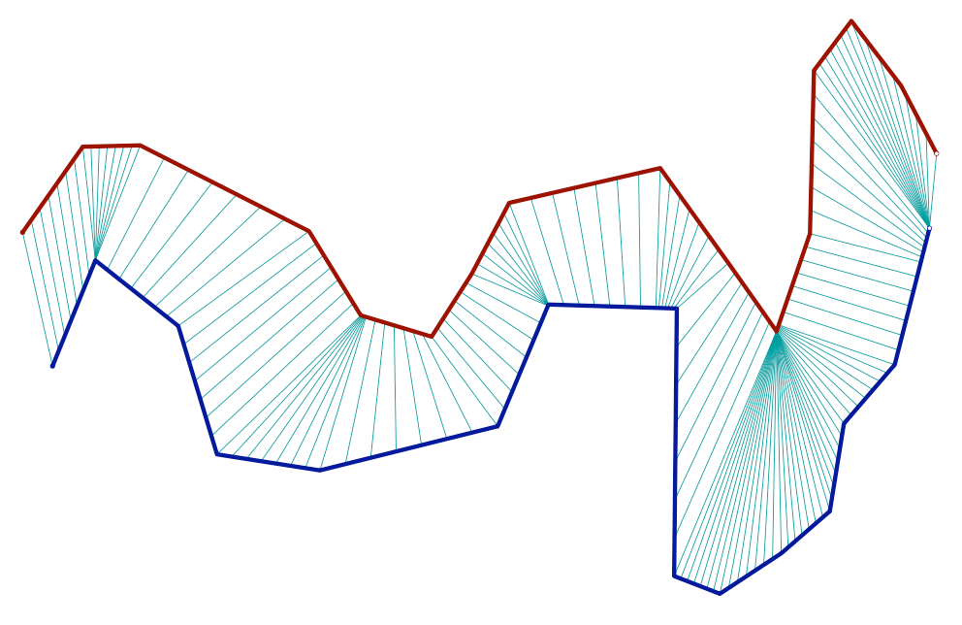
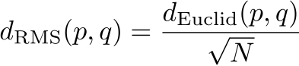
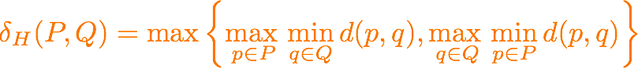
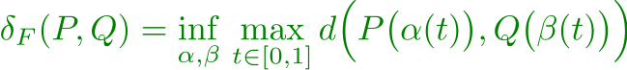
Computational cost
p
P
Trajectories with ~M frames
point-wise distance d(p,q) between frames p and q: e.g.
Hausdorff distance: O(M²) (naïve)
q
Q
discrete Fréchet distance: O(M²) (dynamic programming)
for N trajectories: distance matrix D_{ij} = δ(P_{i}, P_{j})
symmetric; D_{ii} = δ(P_{i}, P_{i}) = 0
N(N–1)/2 distance computations

Slide 10
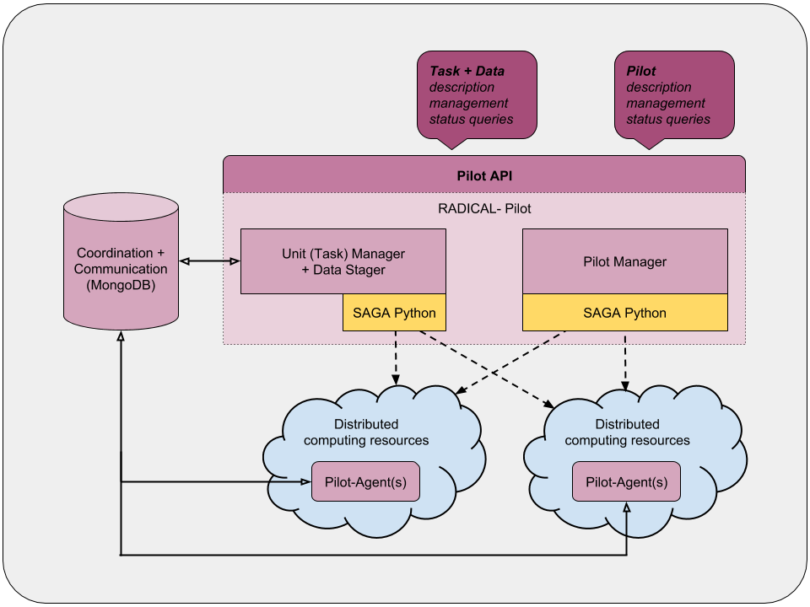
Map-reduce distance matrix calculation with MIDAS radical.pilot
Large number of calculations for a moderate ensemble of trajectories: e.g. N=400 (tutorial): 400 • 399 / 2 = 79,800
BUT: N(N–1) independent calculations (each fairly expensive but of almost constant cost – number of frames in trajectories M is typically similar): pleasingly parallel
MAP – REDUCE
split D into blocks of size w
compute block matrices
recombine blocks into full matrix
radical.pilot
MIDAS radical.pilot to manage jobs for computing blocks: plug in serial MDAnalysis code without additional changes: easy!
Now do the tutorial
http://www.mdanalysis.org/SPIDAL-MDAnalysis-Midas-tutorial/

